Slide 1

Relations, Functions, and Matrices
Mathematical Structures for Computer Science
Chapter 5
Copyright © 2014 W.H. Freeman & Co. MSCS Slides Section 5.2

Slide 2
Topological Sorting
Topological sorting finds a total ordering σ from a partial ordering ρ on a finite set; σ is an extension of ρ, meaning that if x ρ y, then x σ y .
This is indeed a sorting process in the sense that the objects end up being totally ordered (every object is related to every other object),
  but since they must be partially ordered to begin with, it is a very specialized sorting process.
In a finite partially ordered set, an element is minimal if it has no predecessors.
In a finite nonempty partially ordered set, at least one minimal element must exist.
  To see this, let x belong to the set.
  If x is not minimal, then there is a y in the set with y ρ x, y ≠ x.
  If y is not minimal, then there is a z in the set with z ρ y, z ≠ y, and so on.
  Because the set is finite, this process cannot go on indefinitely, so one such element must be minimal.
  A minimal element in a Hasse diagram has no elements below it.
Example: Topological Sorting
There are 254 county seats (a finite set) in Texas.
One topological sorting of County Seats is by altitude.
Therefore the topological minimum would be the county seat that is closest to but above sea level.
Note, these same county seats could be topologically sorted based upon:
  Population
  Average Income
  Diversity, etc
In each case there would always be a minimum.
Section 5.2
Topological Sorting

Slide 3
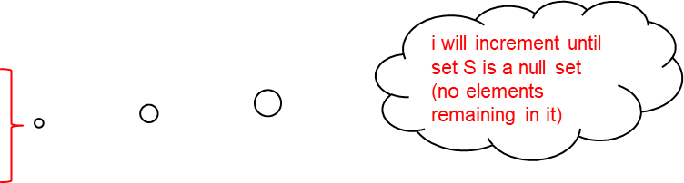
Algorithm: Topological Sorting
TopSort(finite set S; partial ordering ρ on S)
//find a total ordering on S that is an extension of ρ
Local variable
integer i //enumerates tasks in total ordering
i = 1
while S ≠ ∅
pick a minimal element x_{i} from S;
S = S − {x_{i}}
i = i +1
end while
//x₁ < x₂ < x₃ < … < x_{n} is now a total ordering extending ρ
write(x₁, x₂, x₃, …, x_{n})
end function TopSort
This is the function that selects the minimum from amongst the members of S
Section 5.2
Topological Sorting

Slide 4
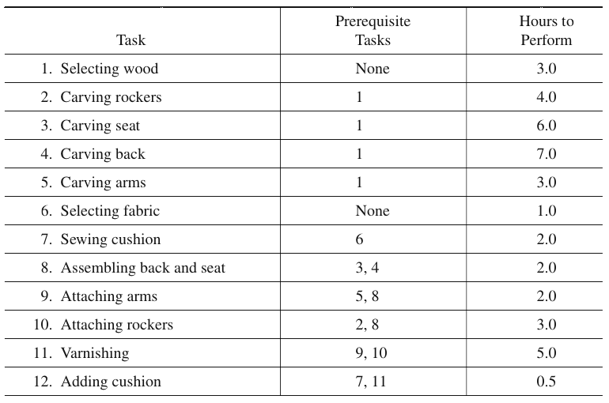
Example: Topological Sorting
Ernie and his brothers run a woodworking shop in the hills of New Hampshire that manufactures rocking chairs with padded cushion seats. The manufacturing process can be broken down into a number of tasks, some of which have certain other tasks as prerequisites. The following table shows the manufacturing tasks for a rocking chair, the prerequisite tasks, and the number of hours required to perform each task.
Section 5.2
Topological Sorting

Slide 5
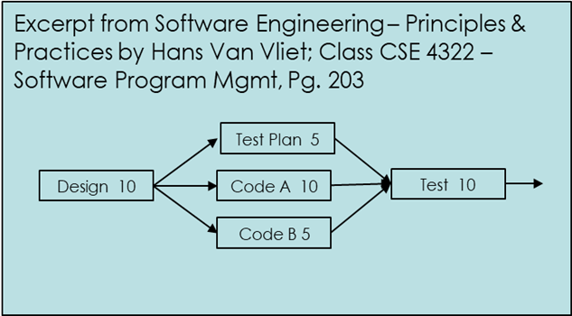
Example: Topological Sorting
We can define a partial ordering on the set of tasks by x ≤ y ↔ task x = task y or task x is a prerequisite to task y.
Quite obviously, this relation is reflexive, antisymmetric, and transitive. Also, x < y ↔ task x is a prerequisite to task y.
In the Hasse diagram for this partial ordering, the nodes are tasks.
  Add to each node the information about the time to perform the task.
  Orient the diagram so that, if x < y, then x is to the left of y rather than below y.
  Thus, the entire diagram runs from left to right rather than from bottom to top.
  Such a diagram for task scheduling is often called a PERT (program evaluation and review technique) chart.
x <= y cannot mean y < x but can mean y = x
x <= y implies x = y or more properly x = x
x <= y, & y <= z then x<= z
Section 5.2
Topological Sorting

Slide 6

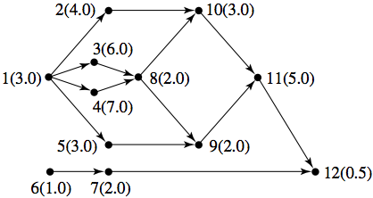
Example: PERT Chart
The PERT chart for manufacturing rocking chairs is shown below, with task numbers substituted for task names and arrows pointing to a task from its prerequisite task(s).
The numbers in parentheses indicate the time required to perform the task.
Section 5.2
Topological Sorting

Slide 7

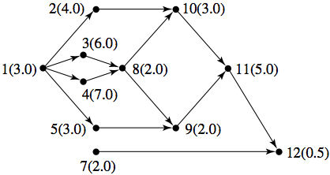
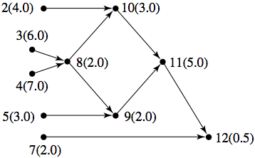
Example: Topological Sorting
One topological sort of the partial ordering of this manufacturing example is 6, 1, 7, 2, 3, 5, 4, 8, 10, 9, 11, 12.
In the figure on the previous slide, either 6 or 1 is minimal and may be chosen as the first element.
If 6 is chosen and removed from the set, then, as shown in the figure (a), either 1 or 7 is minimal.
If 1 is then chosen and removed from the set (figure (b)), then 2, 3, 4, 5, and 7 are all minimal and any one can be chosen next.
The process continues until all nodes have been chosen. If Ernie’s brothers all move to the city and he is left to build rocking chairs alone, the topological sort gives an order in which he can perform tasks sequentially.
(a)
(b)
Section 5.2
Topological Sorting

Slide 8
Example: Topological Sorting
Be careful, does anyone see a problem with Figure (b) if task 2 is selected to be minimum and we are running a program?
  Remember, tasks 2, 3, 4 and 5 cannot start until task 1 has completed from previous figure
To answer:
Task 2 to 10 is not on the critical path!
What is the critical path?
To answer we must determine which is the longest path to get
to task 10?
Task 2 (4 hours)
Task 3 to 8 (8 hours)
Task 4 to Task 8 (9 hours total)
Task 4 to task 8 to task 10 is on the critical path of the rocking chair program, why?
Because if it slips 1 hour or 1 day, the entire program slips 1 our or 1 day
(b)
Take Away:
Program Management must identify and manage the critical path to avoid delays in contractual deliveries due to late payment penalties and damage to the company’s reputation with the customer.
Therefore finding the minimal and identifying dependencies is critical to the master planning function of a program.
As a result not all co-minimums are equal!
Section 5.2
Topological Sorting

Slide 9
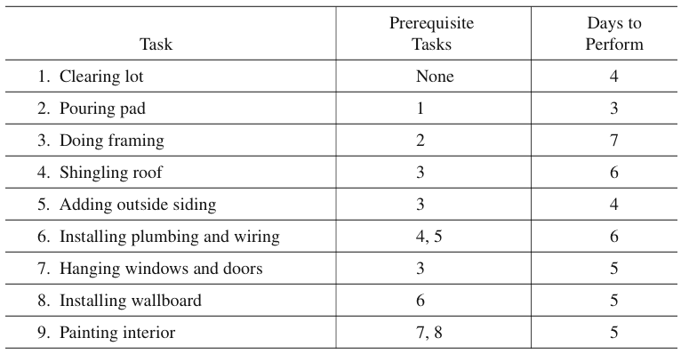
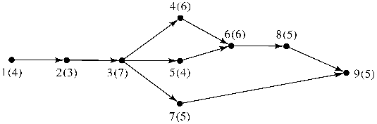
Class Exercise: PERT Chart
Construct the PERT chart for building a house from the following task table.
Section 5.2
Topological Sorting

Slide 10
Class Exercise: Topological Sorting
Give an example of a topological sort for the Pert chart for building a house, shown below:
For example, 1, 2, 3, 7, 5, 4, 6, 8, 9
Is this a valid sort? Yes
Why might it not be optimal?
  Because if this were a real program it does not lie on the critical path.
  What is the critical path?
    1, 2, 3, 4, 6, 8, 9
What is the slack time to get from task 7 to 9?
Answer: 12 Hrs
1. Slack time is time on a task path that is not needed to complete the task
2. A task is not on the critical path if it has slack time
Section 4.2
Topological Sorting

